Slide 1

Prisoner’s Dilemma Simulation
Evolution of Alturism

Slide 2
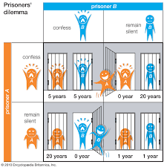
Prisoner’s Dilemma
You can choose to act altruistically or selfishly

Slide 3


My Simulation
More successful programs get to “reproduce” more
Tracks evolution of Moral Strategies
Hypothesis: Altruistic strategies will outcompete selfish strategies

Slide 4
Implementation
Linked list
Each “node” like an organism with a memory
More added based on competitions
Every other node deleted when list becomes too large

Slide 5

Results
During first 5 rounds cooperative strategies won out
After this, selfish strategies became more common and replaced other programs

Slide 6

Interpretation
Due to the structure of the Code:
Programs were more likely to be paired off with similar programs in the beginning, increasing the viability of cooperative strategies
In later rounds, pairings were more random

Slide 7

Test : Create 2 new simulations
One where it’s pairing is random the entire time(Sim2)
- Result : Uncooperative strategies win immediately
One where the programs are clustered the entire time(Sim3)
- Result : Cooperative strategies win
My interpretation was supported!

Slide 8

Application / Future Directions
Altruistic strategies are more viable when used on relatives
Reputation may also help discourage selfishness, but was not included in my simulation

